Slide 1
Lets Chat

Slide 2
Team Working on Idea !
Nischal Prajapat { 0805CS1863 }
Rohitdutt Parsai { 0805CS181084 }
Raj Gujrathi { 0805CS181074 }
Nidhi Rani { 0805CS181059 }
Special Thanks to Prof. Rajan Thakur for guiding us throughout the project
For Source code refer Let's Chat

Slide 3
Submission
Submitting to Jawaharlal Institute of Technology , Borawan for course
B.Tech { Computer Science Engineering } in Semester V { 2020 - 2021 } as a
Fulfilment of Minor Project

Slide 4
INTRODUCTION
Let’s chat is a chatting application which intend to make real-time communication possible . people can talk like having real conversation face-to-face . The user can login to the application and create room for their chat and room-id with others so that they can join the chat with them .
The purpose of the chat application is to allow users be able to the chat with each other, like a normal chat application. The users will be able to chat with each other, most likely only for group chats , no one-to-one chatting will be developed, unless there is time to do so. The chat application will be written in javascript , for the scope of the project, the project will be tested as the program is being developed. A client/server interface will be developed and tested . When the chat application is near completion, more testing will be done in order to make it less buggy or more user friendly. The target audience is any person who wants to Communicate with people remotely.
The application will be designed such a way that can be easily schalable so that if needed it can scale accordingly.

Slide 5
OBJECTIVES
Provide a simple and best User Experience .
To Allow Share their thoughts and views .
Connecting people securely .
Design Powerful scalable , available application so that best value can be provided to user .

Slide 6
TECHNOLOGIES WE ARE USING !
Programming ->
JavaScript
HTML
CSS
SQL
Frameworks ->
React.js
Node.js
Express.js
Jest.js ( Testing )

Slide 7
HOW ITS DIFFERENT
We implemented secure session followed up by JWT.
Our application provides end to end encryption and there will be no traces of message after user sign out from the chat room so it is highly secure
It is highly responsive web-application that’s why we can open it on any device of aspect ratio
We will provide minimum latency and Throughput for best experience

Slide 8

HOW APP PROCEEDS
Backend server 1
Receiver 1
Type text and send message
Yes
Load
Balancer
/ CAMS
Receiver 2
Backend server 2
Sender
Receiver N
Sign out or Exit Application
No
Database

Slide 9
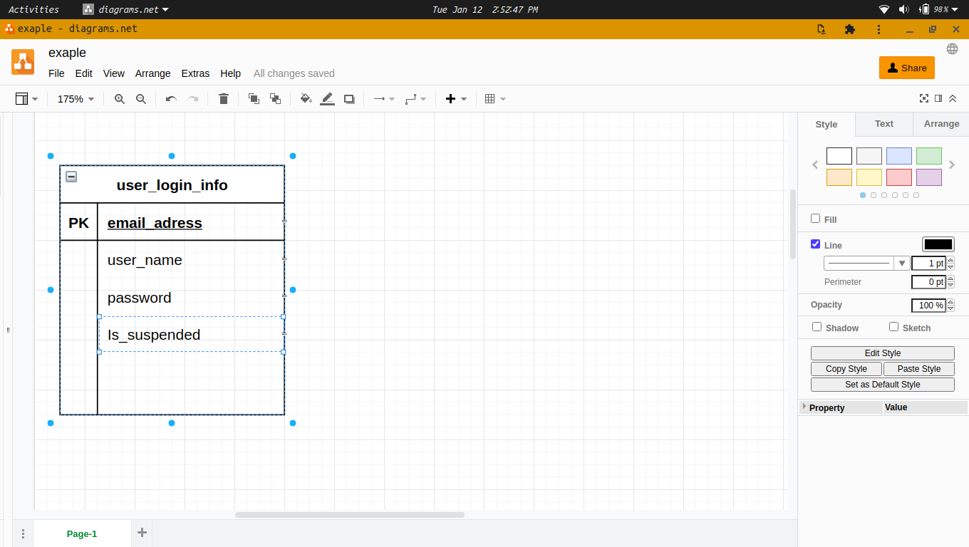
DIAGRAM

Slide 10
GOALS
Functional Requirements ->
Users should be able to Send and Receive message.
Users should be able to connect anytime.
Users can end chat anytime.
User should be able to see whom he is talking to.
Non-functional Requirements ->
Our service needs to be highly available.
The acceptable latency of the system is 200ms for message to broadcast {may change depends upan network }).
Consistency can take a hit (in the interest of availability).
The system should be highly reliable;.
Not in scope -> Adding photos, searching photos or messages ,selecting photos or messages, user seen message or not.

Slide 11
Things We May Work On If We Achieve Our Goals Early
End to End Encryption .
Read Receipt .
To See if User is Online or not .
Register with us .
Generate a cyphered link to join chat .
Make a Progressive Web App .

Slide 12
Some Design Considerations
The system would be data intensive , so we will focus on building a system that can move data quickly.
Practically, users can upload as many message as they like; therefore, efficient management of servers should be a crucial factor in designing this system.
Low latency is expected while viewing sending and receiving messages.
Data should be 100% reliable. If a user sends a message , the system will guarantee that it will never be lost until receiver receives.

Slide 13
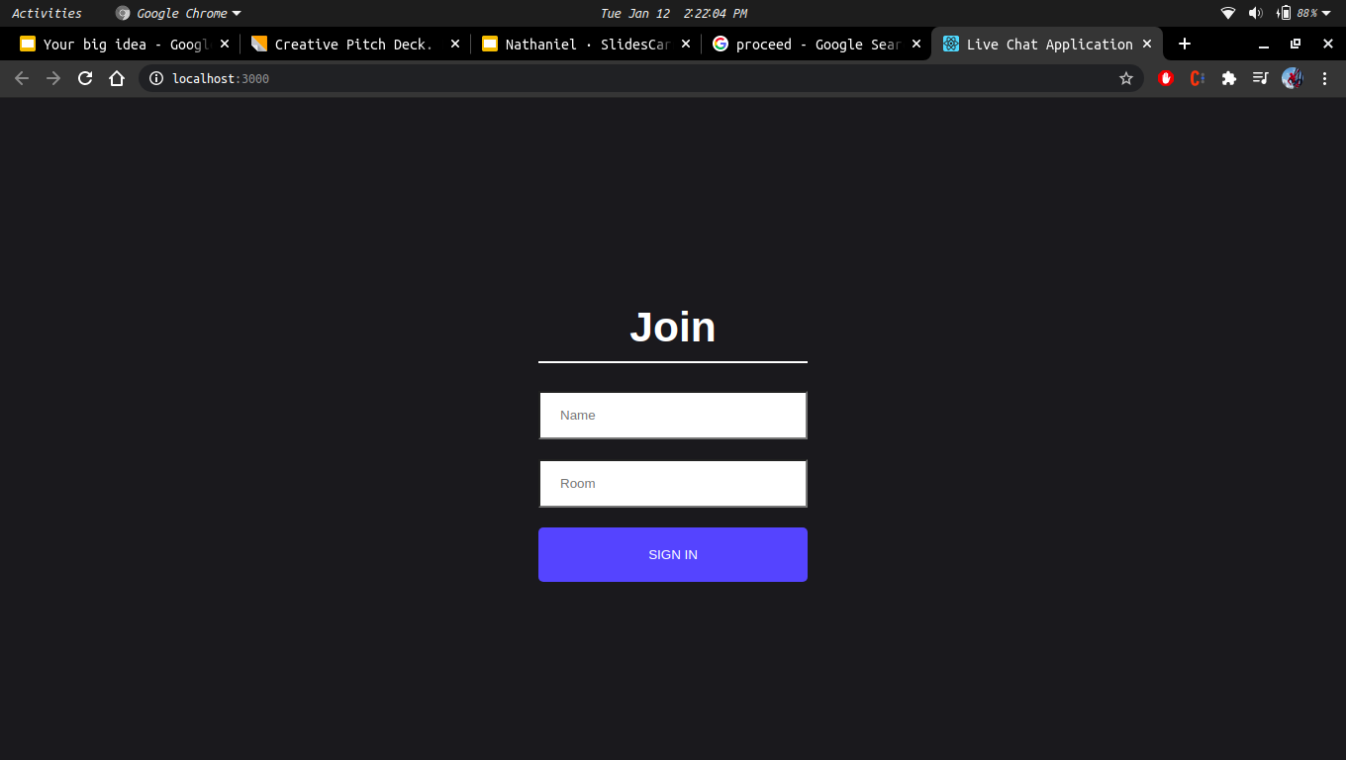

Slide 14
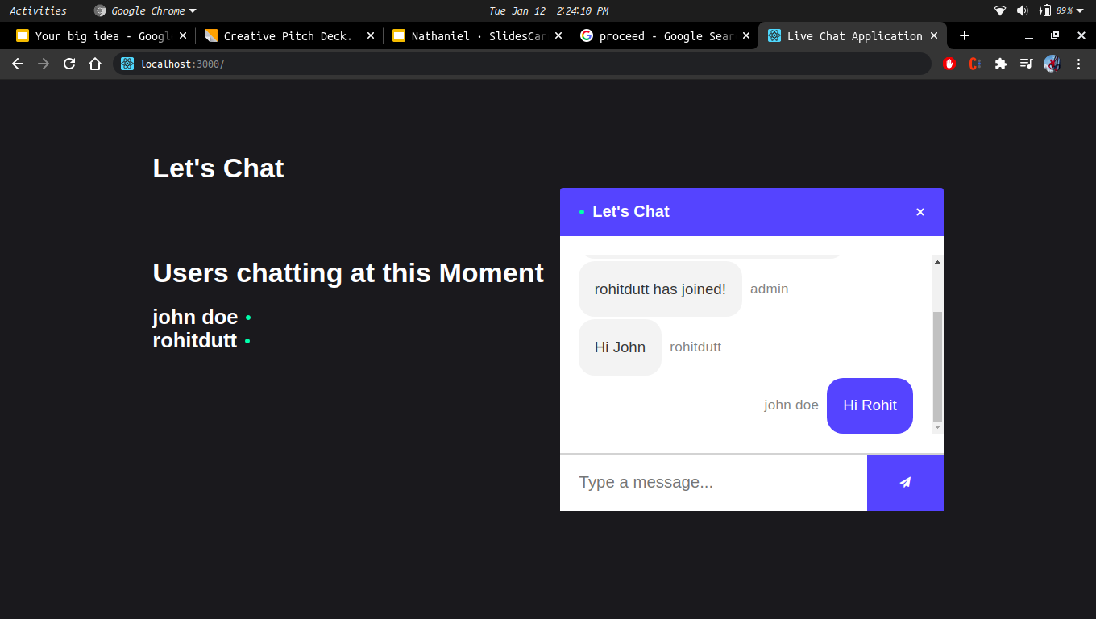

Slide 15
In Next Slide You Can See Some Code Snippets !

Slide 16
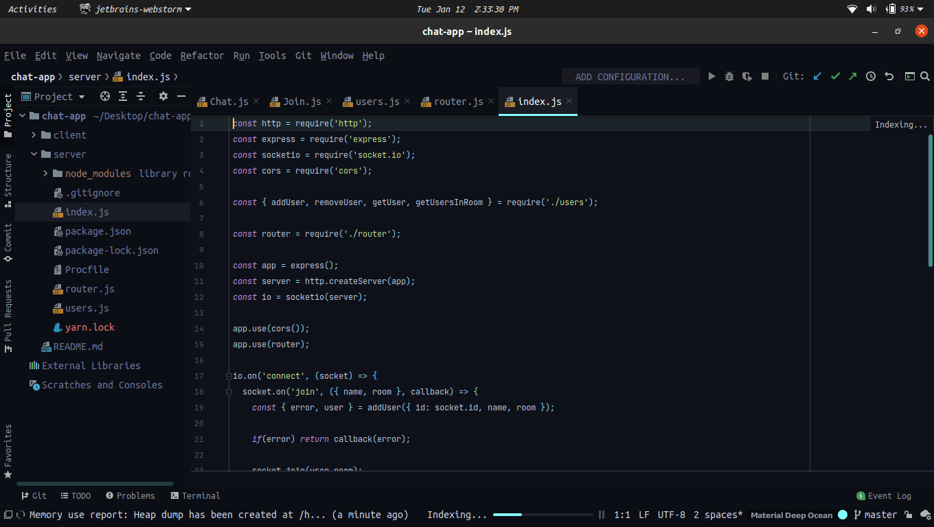
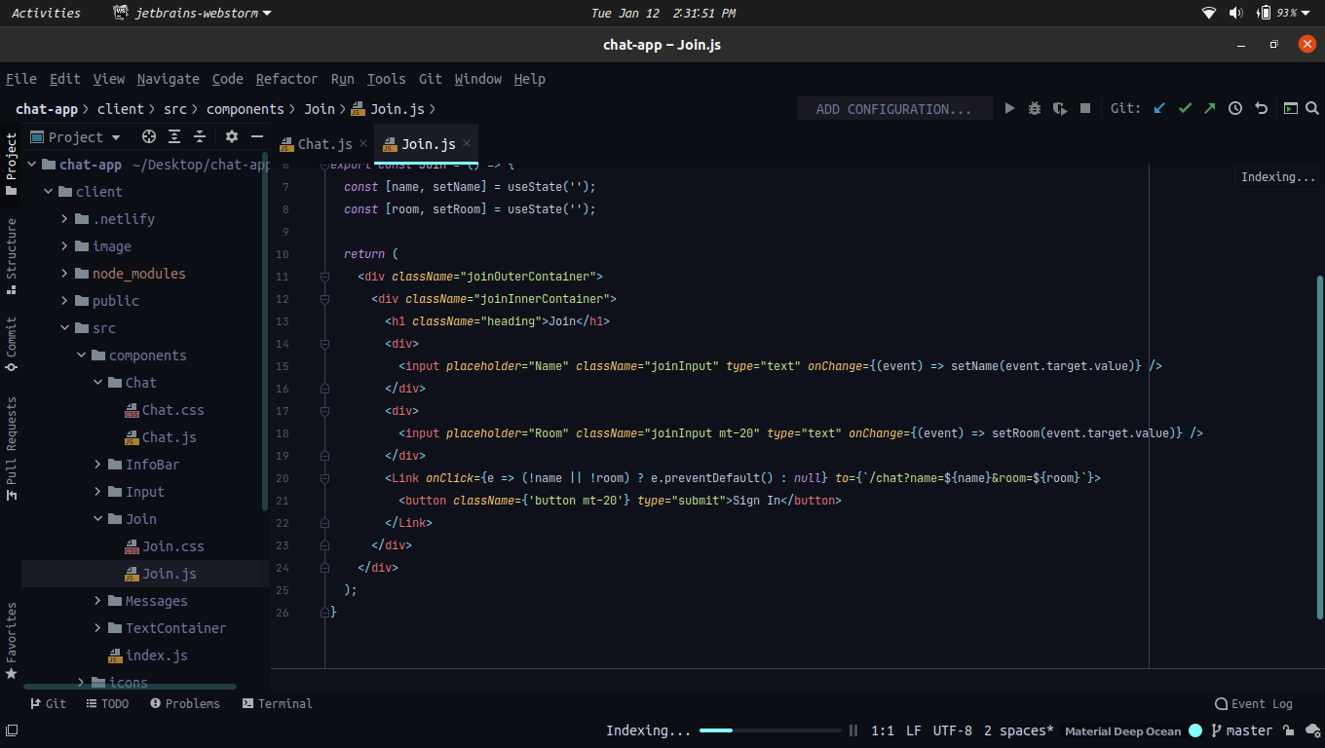
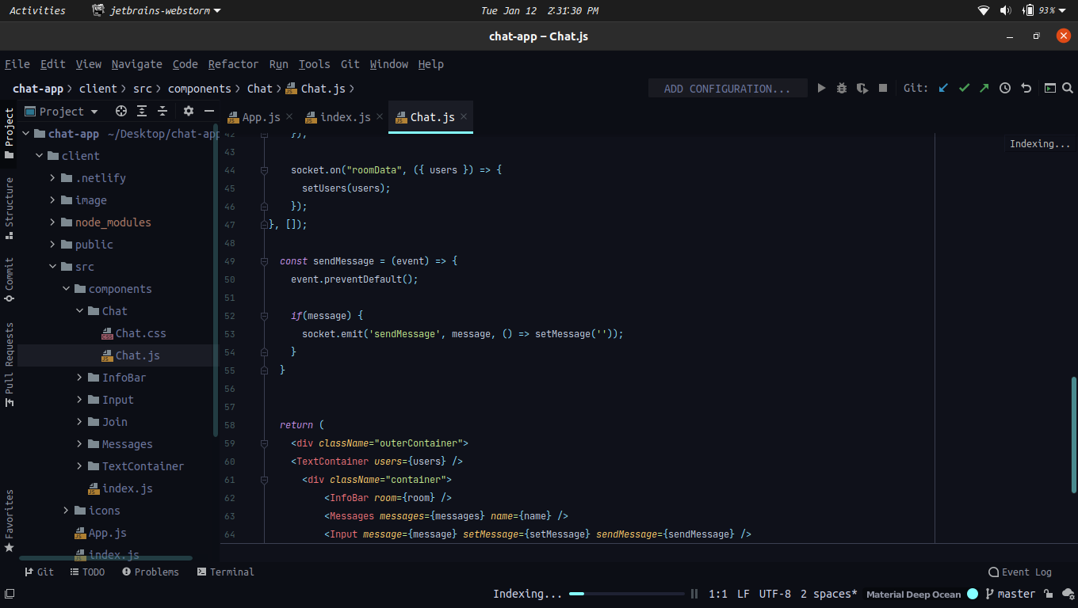

Slide 17
THANK YOu !
We Hope that you Like Our Project

